Slide 1
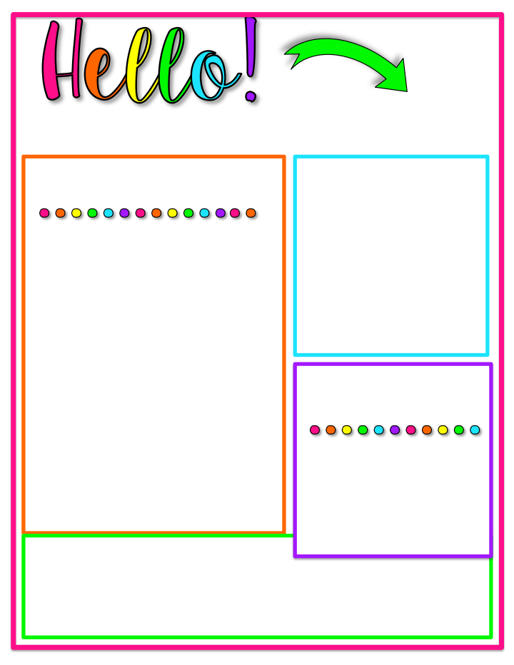
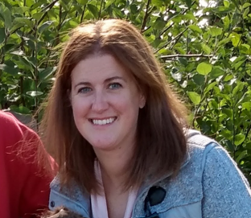
I’m Mrs. Huntley
I am excited to introduce myself as your child’s 5th grade teacher. I wanted to share a little bit about myself. This is my first year teaching 5th grade and my first year at HBM Elementary. I previously taught first grade in North Carolina. This will be my ninth year of teaching.
For the past eight years I have stayed at home with my daughters. Madelyn is 9 years old and is in 4th grade. Olivia is 6 years old and is in 1st grade. They keep me very busy. I am very excited to get back into teaching.
I look forward to a great year and am excited to get to know your child this year.
Favorite Things
Color: green
Place: the beach
Treat: anything chocolate
hobby: arts and crafts
Please feel free to contact me with any questions or concerns.
Email: Sarah.Huntley@rcsdk12.org
Phone: 585-266-0331 ☺

